Slide 1
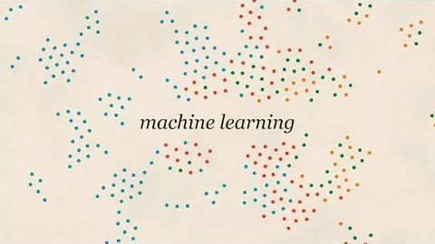

Slide 2
Let’s discuss why…

Slide 3
Ethics
João Sedoc
Johns Hopkins University
December 4, 2019
Some content from E. Heizer & A. Roth & Z. Ives and L. Ungar & Yulia Tsvetkov and Alan Black

Slide 4
A problem for AI and Ethics
Consider the following rudimentary ethical questions about AI:
What should the ultimate good of AI?
What makes an AI innovation good vs. bad in a moral sense?
How should AI function such that it promotes its ultimate good?
Problems:
We’re building artificial intelligence that is increasingly taking on the role of thought partner, information broker, medical expert, and social engineer
There are no robust frameworks for evaluating the ethics of AI
Industry won’t figure this out for us

Slide 5
“Automated” decisions impact every aspect of our lives
Admission to schools
Who to hire and who to fire
Work schedule
Who to date
Whether to grant a loan
What ads are shown, discounts are given
….

Slide 6
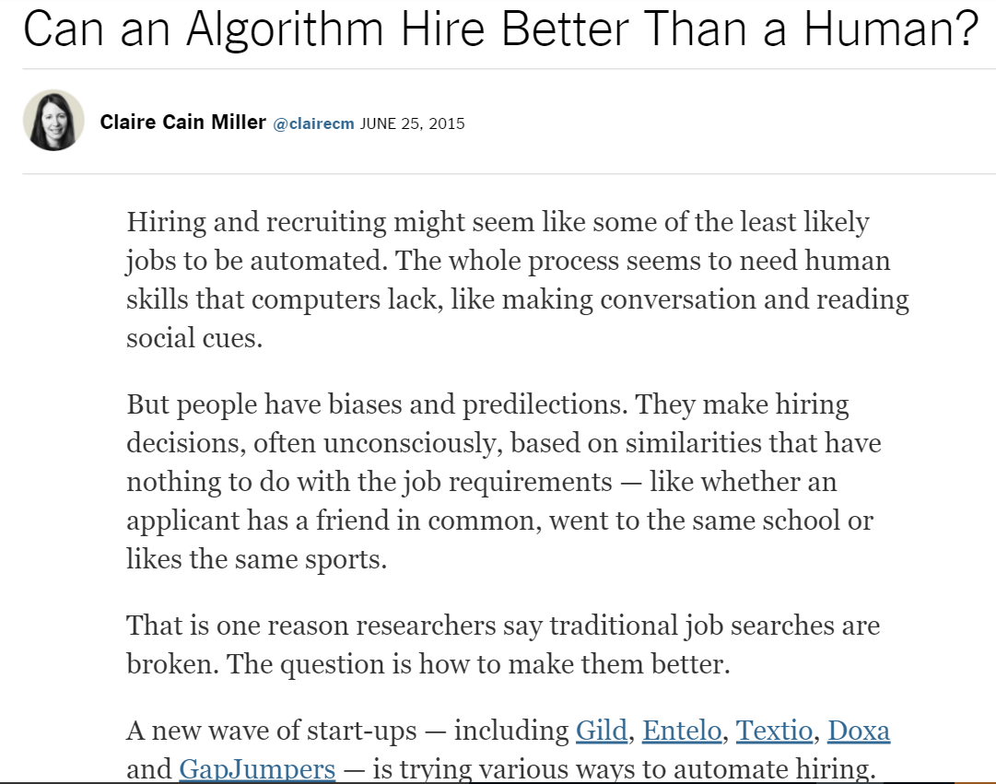
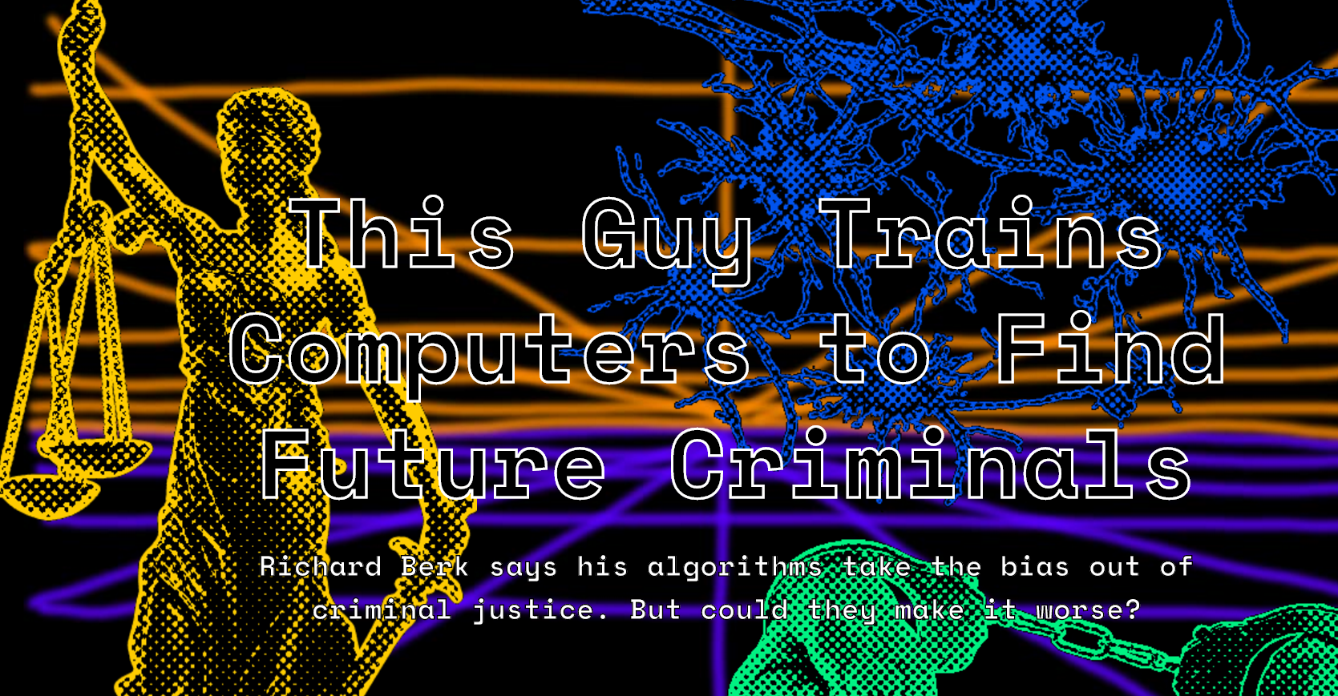
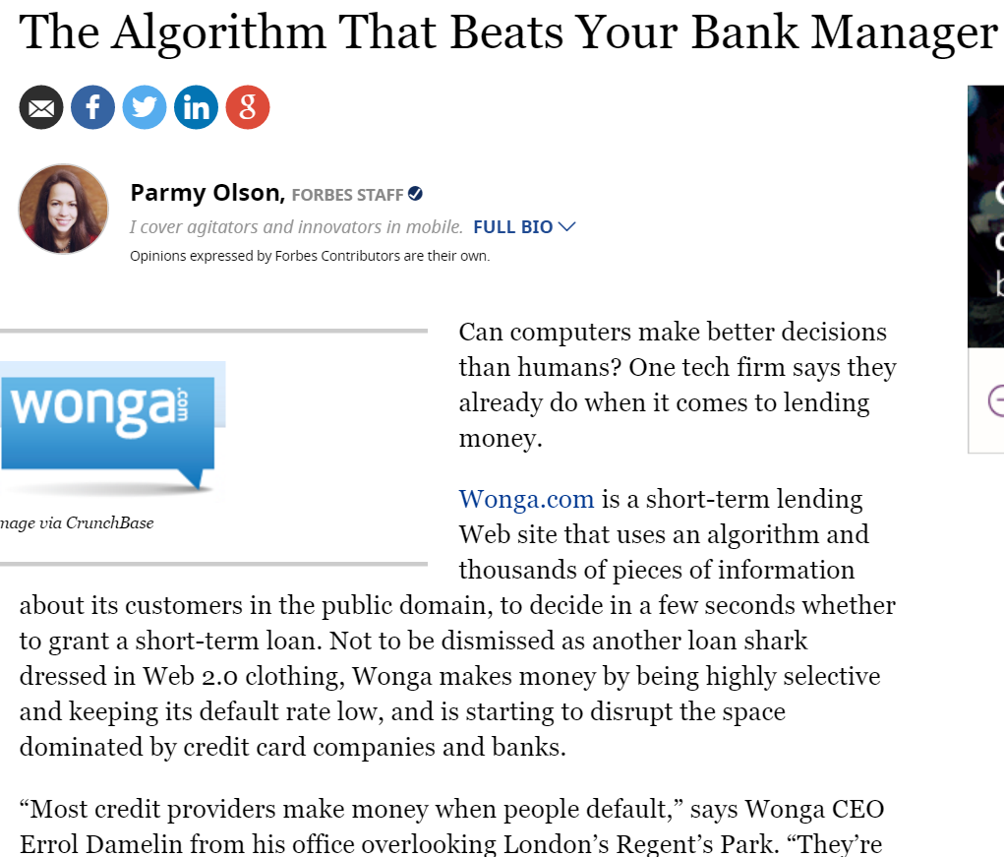
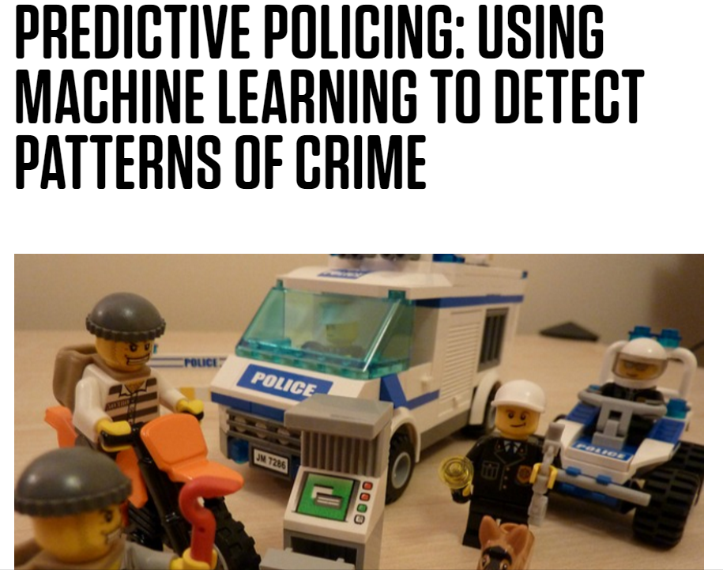
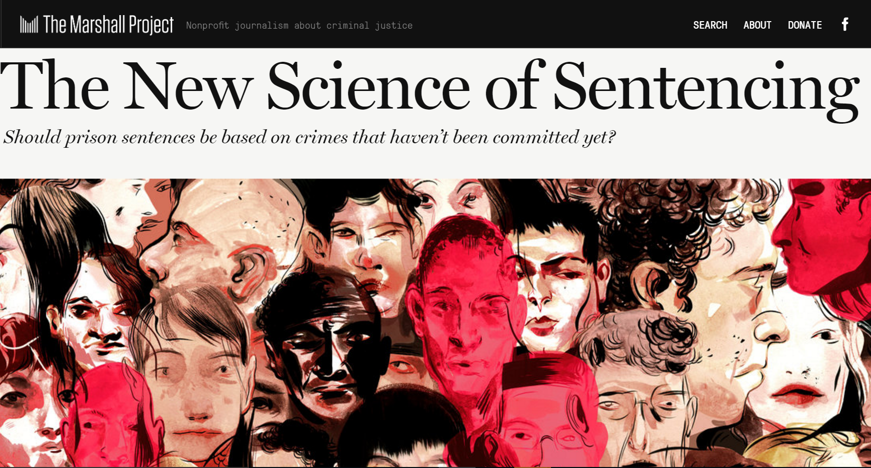

Slide 7
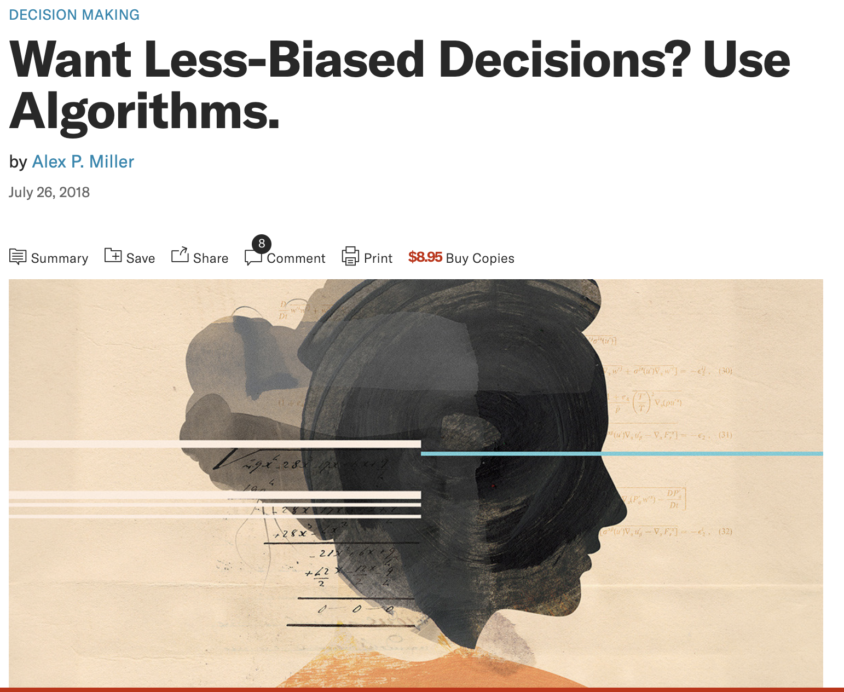

Slide 8
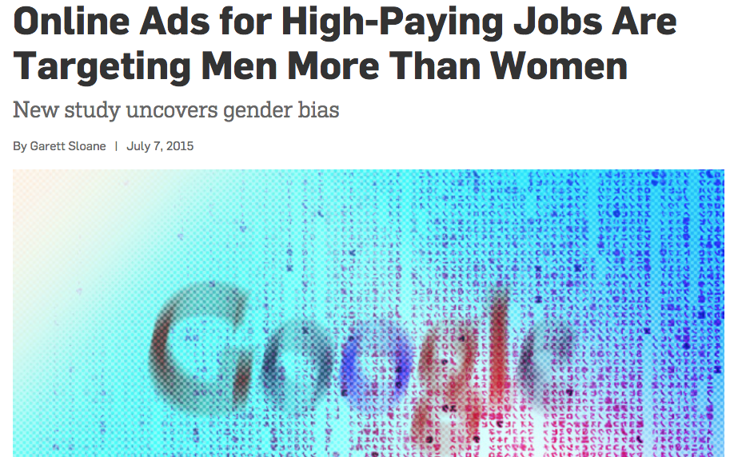
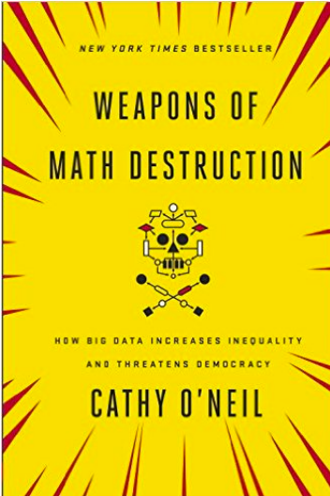
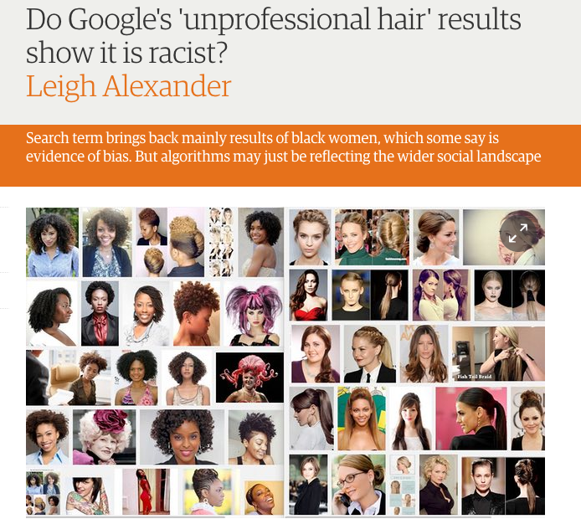
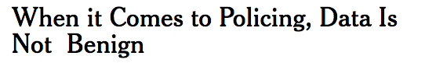
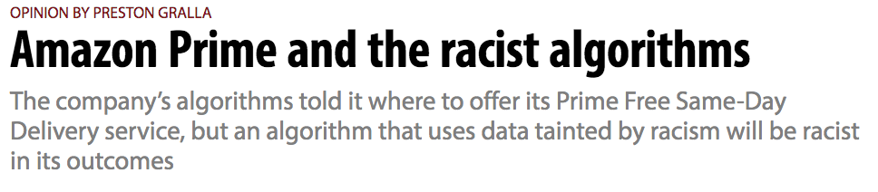
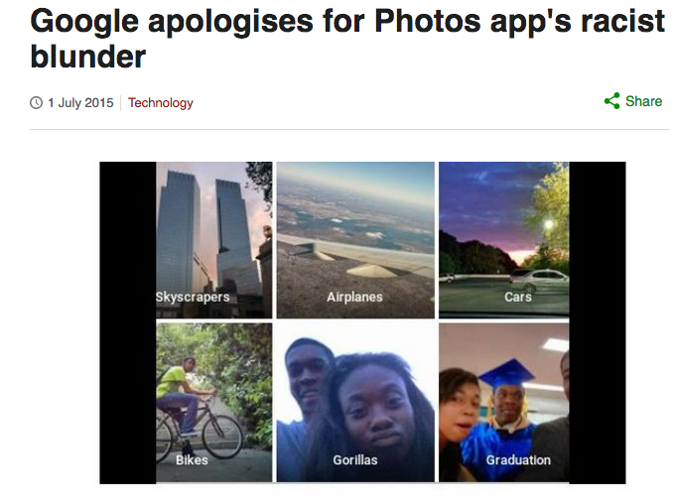
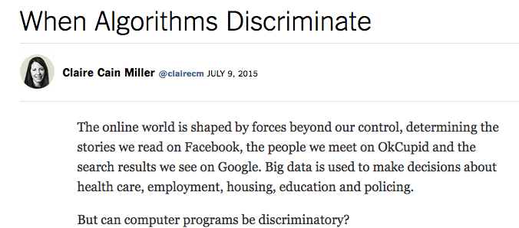
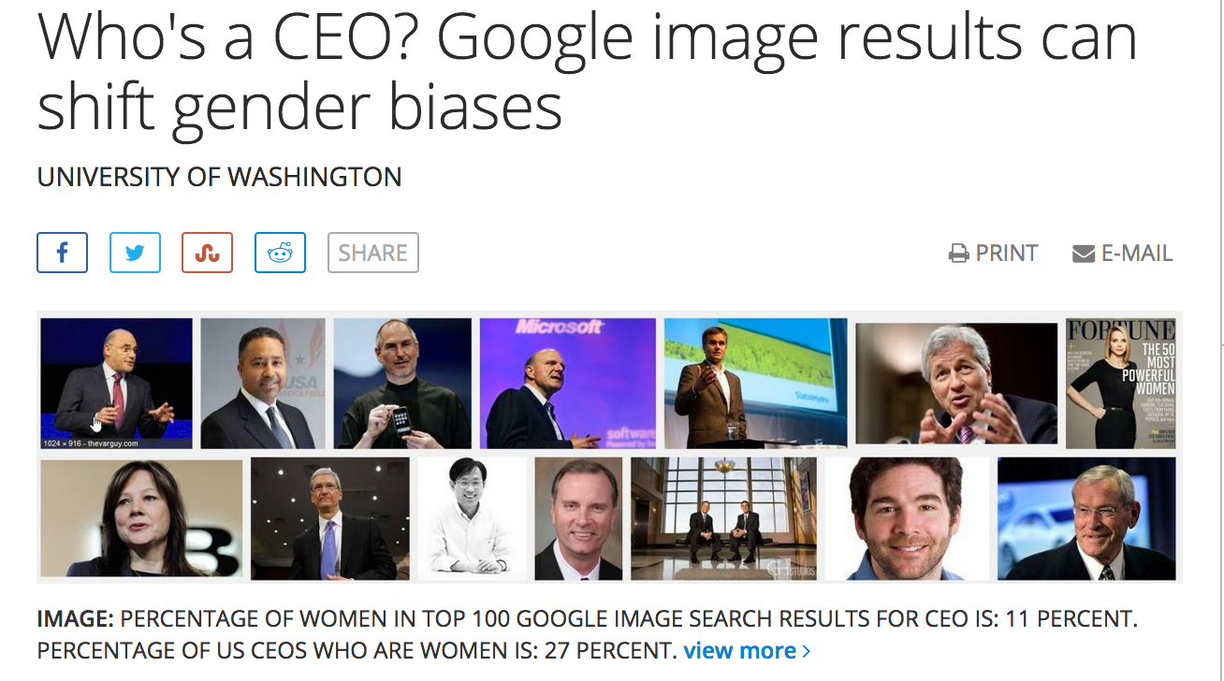
Slide content courtesy of Hanna Wallach

Slide 9




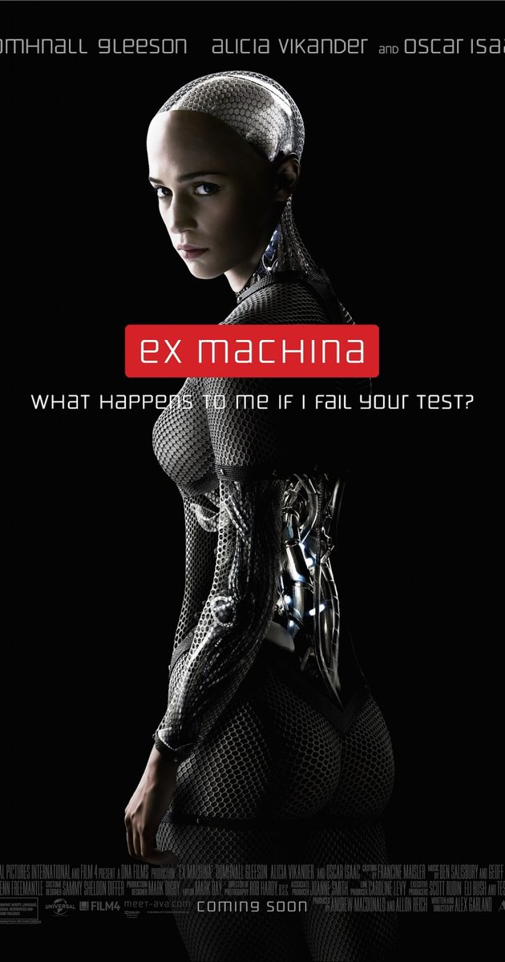

The Long History of Ethics and AI
Notes:
God
Golem
Frankenstein
I Robot: Isaac Asimov
Ex Machina
Black mirror
Westworld: what is permissible and what is prohibited

Slide 10
You need to understand the ethical issues surrounding the data you obtain/use, the algorithms you employ, and its impact on people.
Well I’m just an engineer?

Slide 11
The Dual Use of A.I. Technologies
Who should be responsible?
The person who uses the technology?
The researcher/developer?
Paper reviewers?
University?
Society as a whole?
We need to be aware of real-world impact of our research and understand the relationship between ideas and consequences

Slide 12
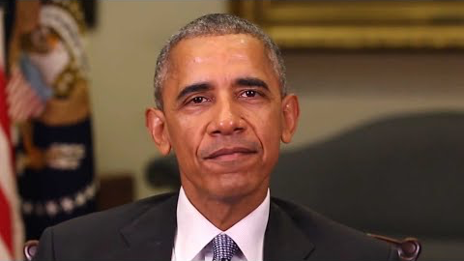
Deepfakes

Slide 13
Misconceptions about AI that can lead to harm
Engineers are only responsible for their code, not how the code is used or the data quality
Humans and computers are interchangeable; replacing humans with computers results in better outcomes
Regulating the tech industry is too hard and won’t be effective
Our job in tech is just to optimize metrics and respond to customer demand
From Rachel Thomas FastAI

Slide 14
What we’ll discuss…
What are ethics?
Ethics surrounding data
Privacy and informed consent
Ownership and intellectual property
Ethics surrounding algorithms
Biased algorithms
Bad results from good data
reproducibility
Fairness

Slide 15
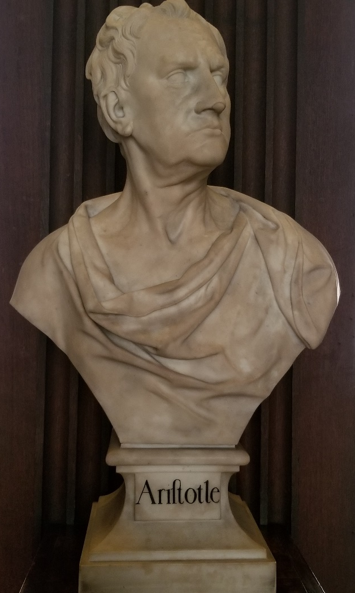
Virtue ethics for humans
Virtue ethics offers an alternative to rule-based ethical systems (e.g., deontology, utilitarianism)
Virtues are the qualities of people that promote human flourishing
Virtue is attained by:
performing one’s distinctive function well
cultivating intellectual and moral excellence
achieving proper inner states; i.e., those consistent with virtue
Virtues may be cultivated based on learning and emulation

Slide 16
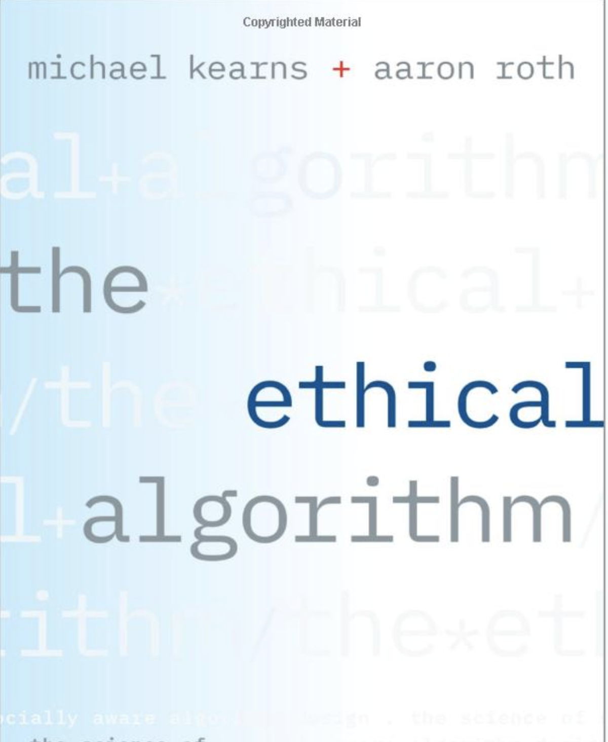
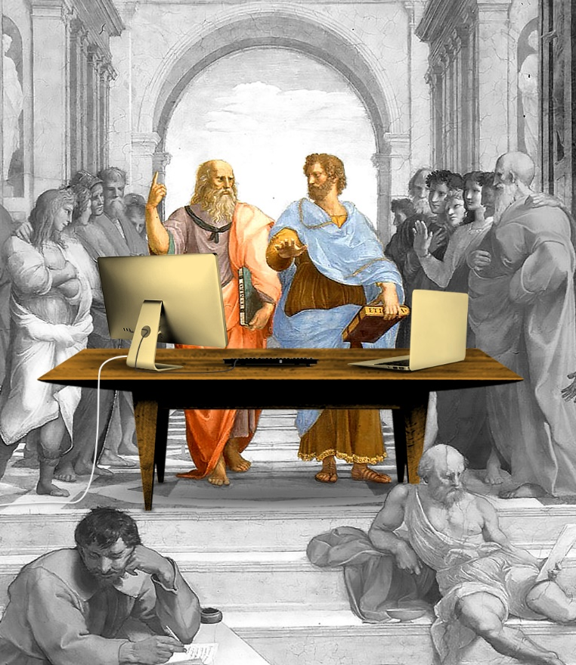
Algorithmic Virtue ??? Ethical Algorithms

Slide 17
Identifying algorithmic virtue
We want to make normative claims about what makes an algorithm good (and they kind of sound like Aristotle)
To be good, algorithms must perform their function well (intellectual virtue)
The distinctive function of a predictive algorithm is to predict correctly; the virtuous algorithm is one that attains excellence in prediction
It is not enough that predictive algorithms make accurate predictions; to be good, they must arrive at their predictions for the right – i.e., normative and just – reasons (moral virtue)
An algorithm that makes an accurate prediction based on discriminatory/ prejudicial information acts contrary to virtue

Slide 18
Need to embed social values in algorithms
Requires being precise about the definitions, developing their consequences.
Privacy
Fairness
Accountability
Interpretability

Slide 19
Ethics Surrounding Data

Slide 20
Ethical Principles
Autonomy
The right to control your data, possibly via surrogates
Informed Consent
You should explicitly approve use of your data based on understanding
Beneficence
People using your data should do it for your benefit
Non-maleficence
Do no harm

Slide 21
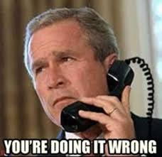
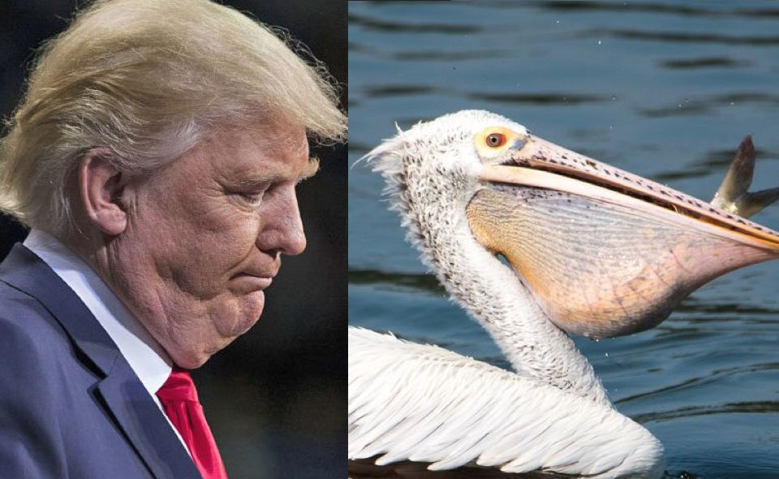
Data Collection
Data is constantly being collected about us
Cameras
Location reporting
Accelerometers
Social media
Do I own data collected about me?
What if I don’t like what the data says about me?
Can I control how the data is used?

Slide 22
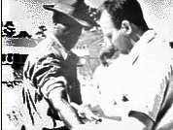
Data and Informed Consent
In human subjects research, there is a notion of informed consent
must understand what is being done
must voluntarily consent to the experiment
must have the right to withdraw consent at any time
Not required in “ordinary conduct of business”
E.g. A/B testing
But this is a very thin line….

Slide 23
Informed Consent
Informed consent is often buried in the fine print
Data is often collected first; the experiment comes later.
How the data, once collected, is going to be used is difficult to control.

Slide 24
OKCupid Experiments with Customers
Love Is Blind day
Suppressed photographs in user profiles so that the customer would not be able to see the profile photographs of potential people to meet.
Customers could still read what was written in profiles, e.g. interests.
Impact on success of a date on being told you are compatible? In addition to reporting accurate compatibility scores:
Took people with low compatibility score, told them it was high
Took people with high compatibility score, told them it was low
Three by three test matrix: 30, 60 and 90% compatibility score actual versus 30, 60, and 90% declared

Slide 25
Was this legal/ethical?
CEO Christian Rudder: “But guess what, everybody: if you use the Internet, you’re the subject of hundreds of experiments at any given time, on every site. That’s how websites work.”
On the other hand, having a company intentionally lie to you, intentionally give you a wrong score, is something that many people consider socially unacceptable.

Slide 26
Intellectual Property
Artistic expression can be copyrighted: exclusive legal right to print, publish, perform, film or record and authorize others to do the same.
Derivative work can be created with permission.
There’s also a notion of citation, in which we give credit to the owner.
What about data?
Wikipedia, Yelp, Rotten Tomatoes, TripAdvisor

Slide 27
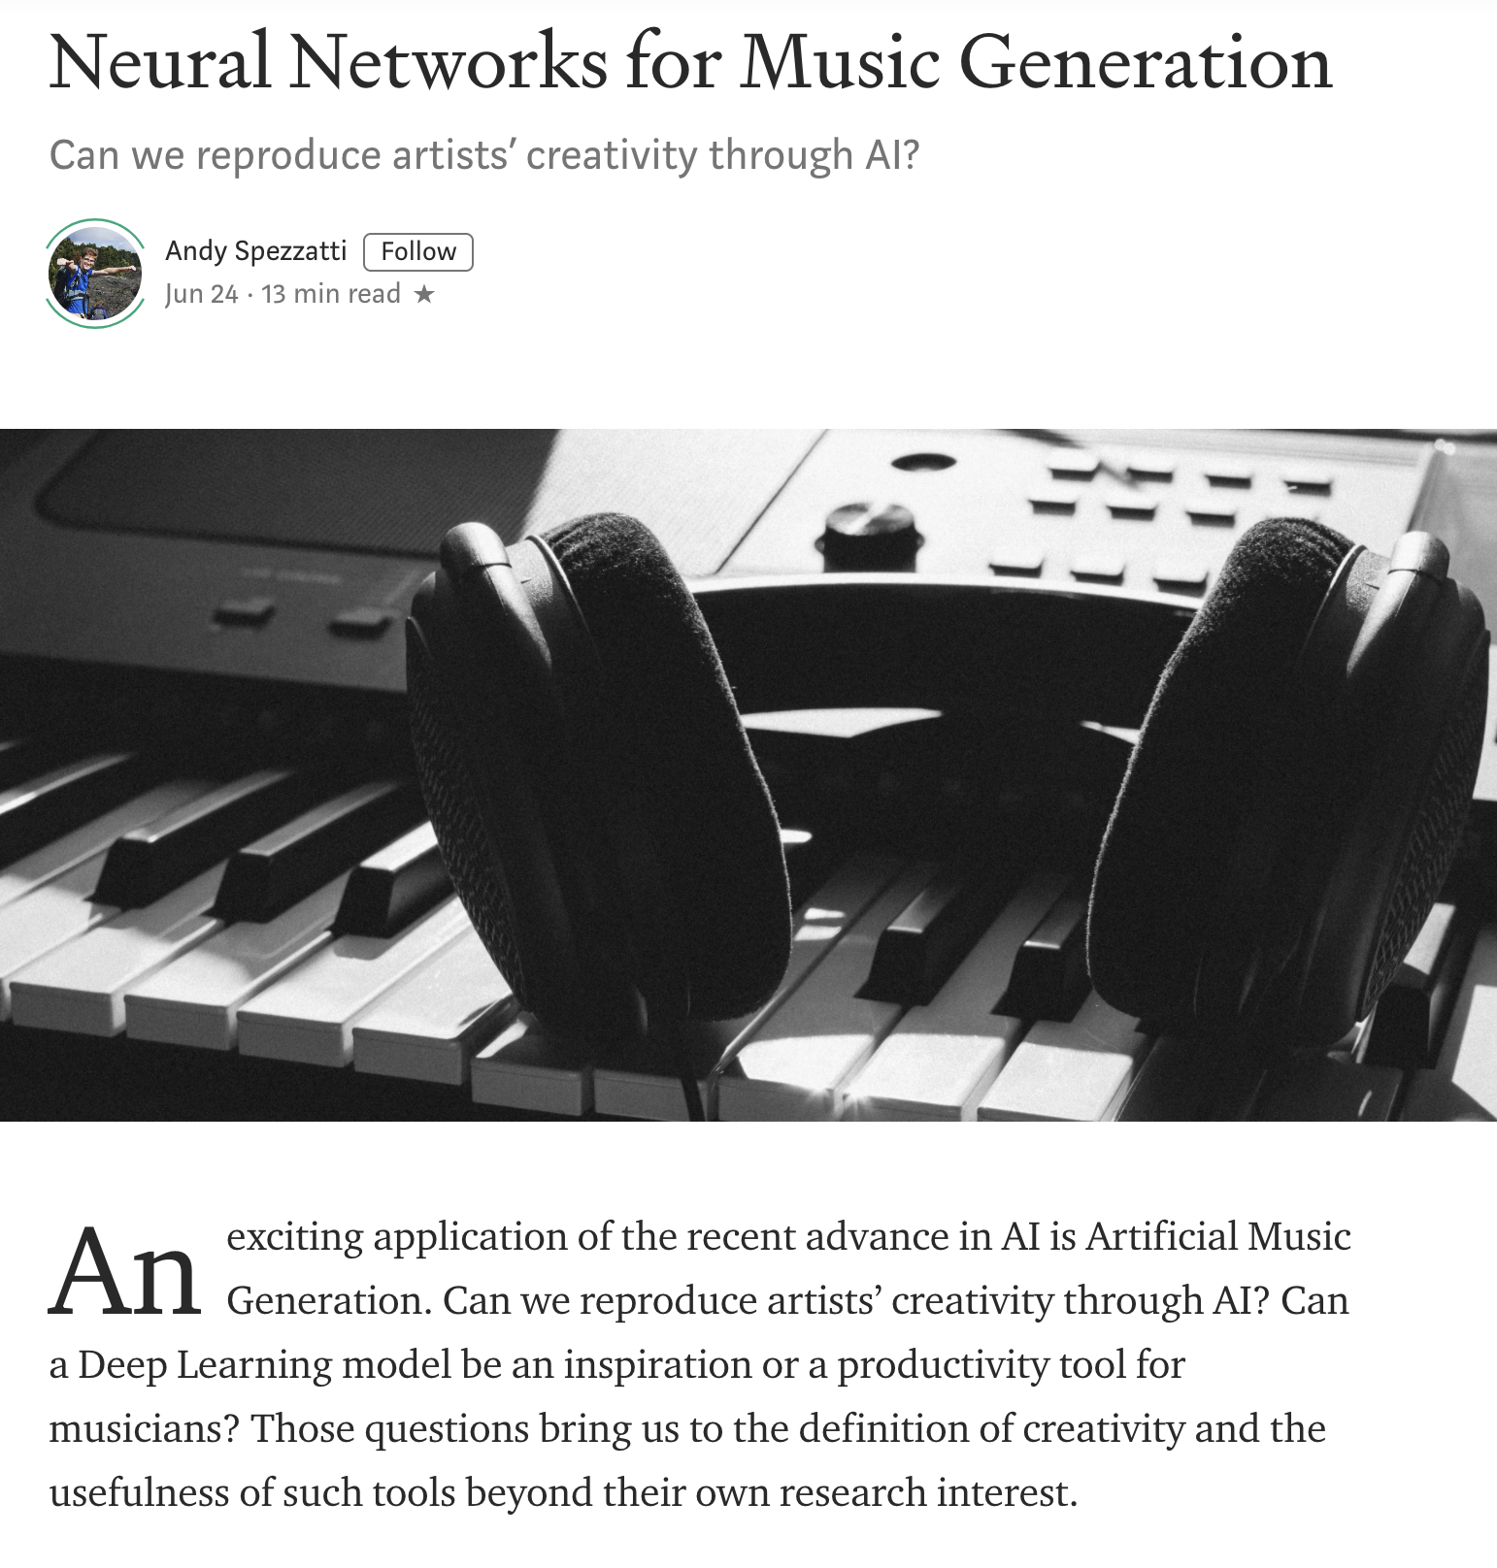
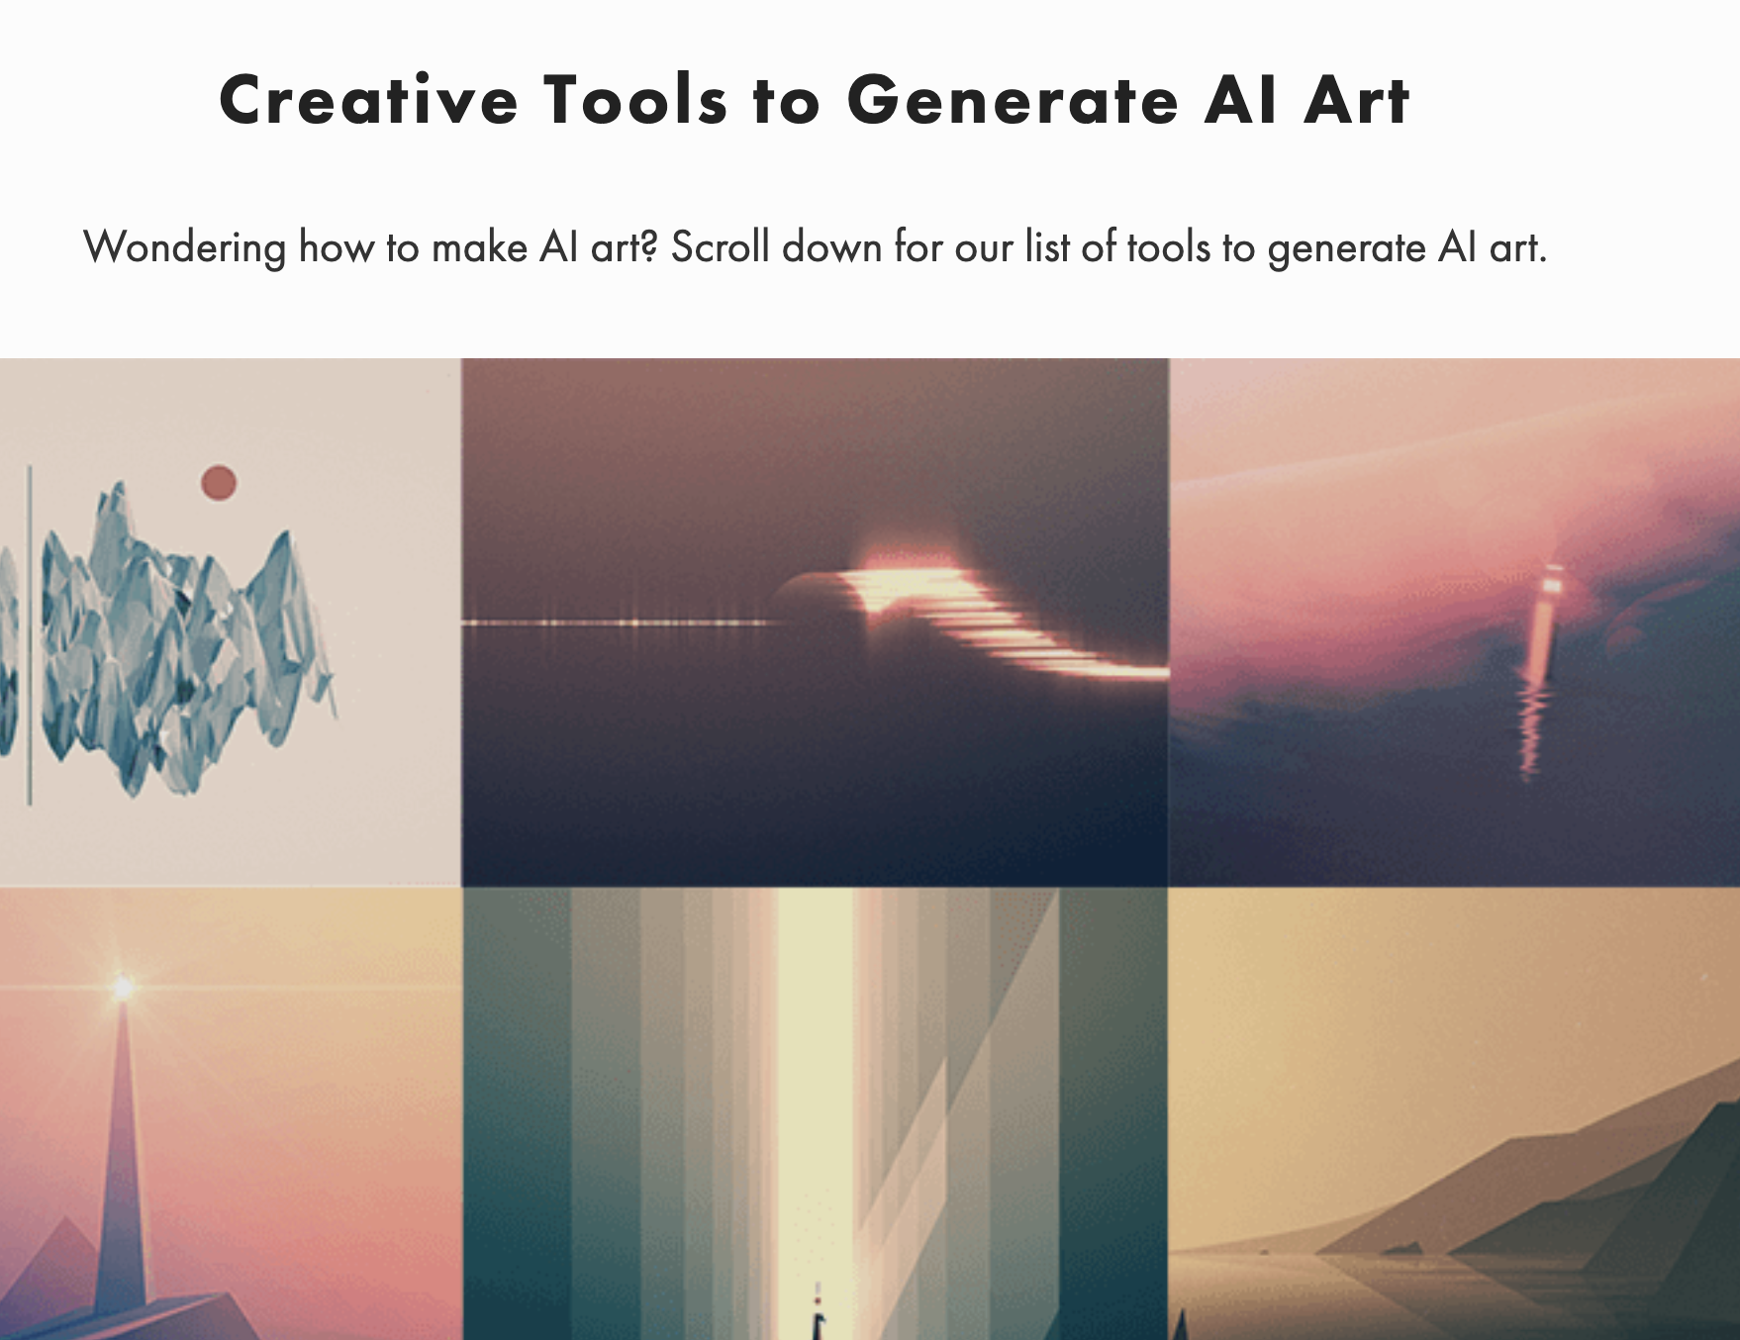
Intellectual Property - Copyrights

Slide 28
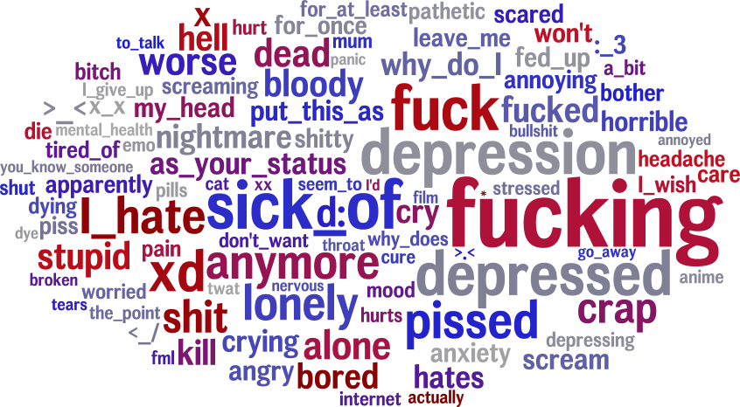
What can we learn from your social media posts?
Neurotic

Slide 29
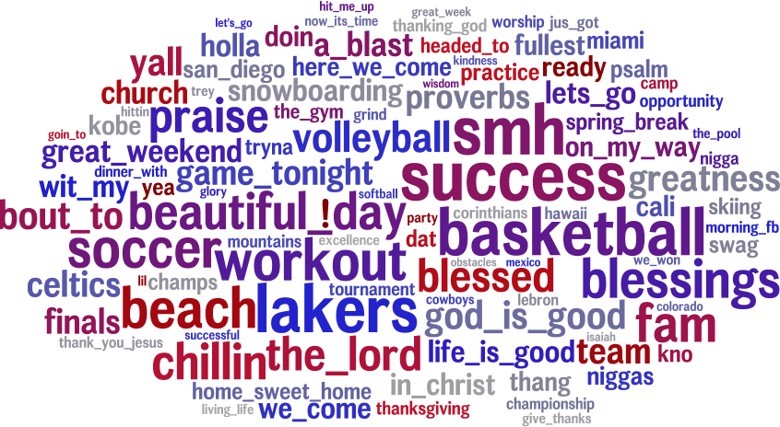
What can we learn from your social media posts?
Well adjusted

Slide 30
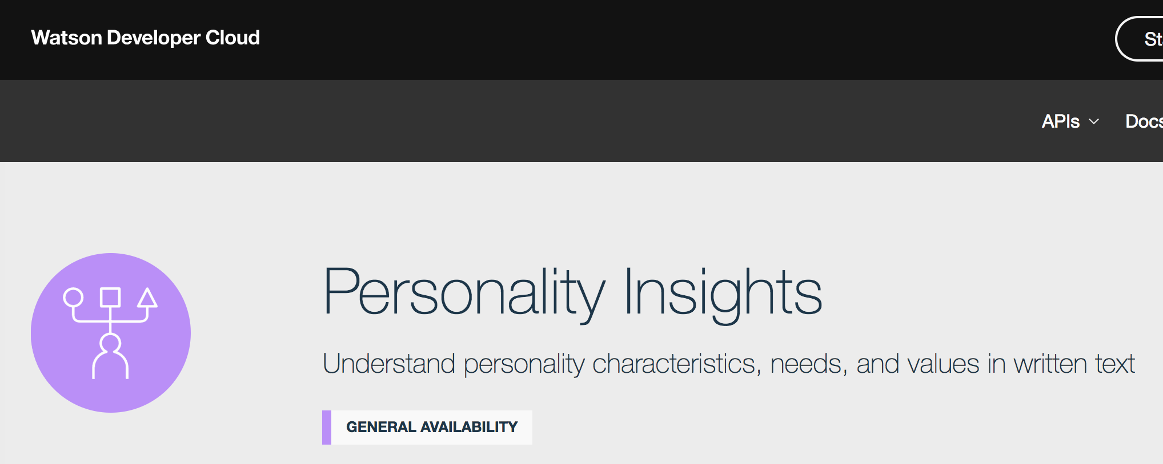
Targeted marketing from IBM

Slide 31
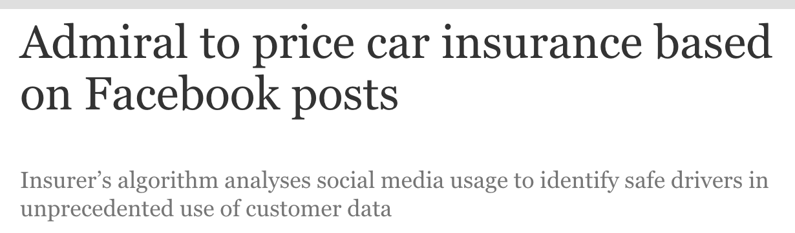


Slide 32
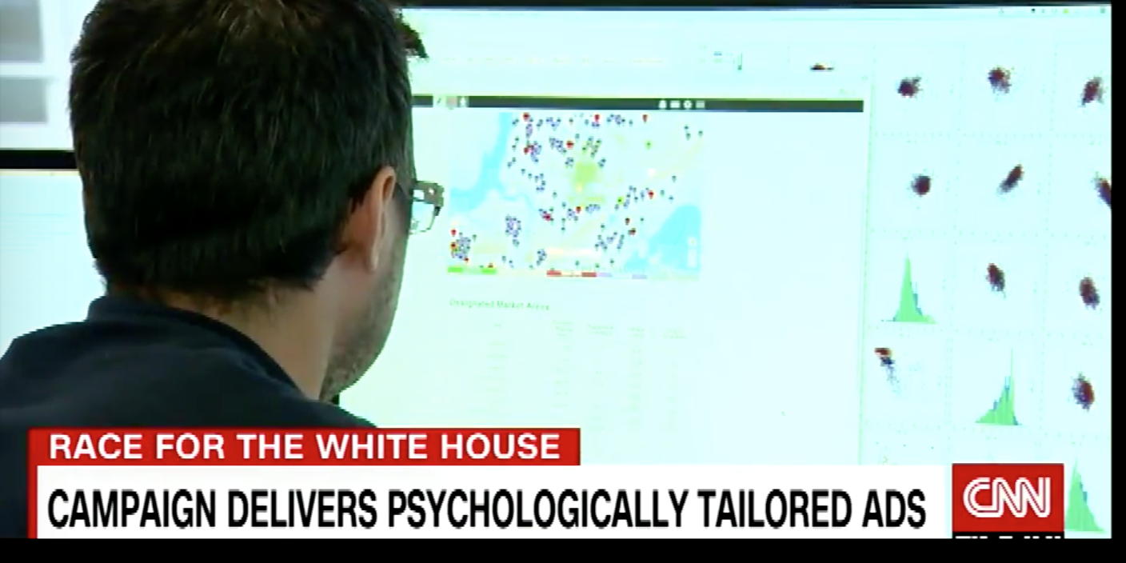
Targeted marketing: Cambridge Analytica

Slide 33

Privacy
Notes:
Privacy is a basic human need
Privacy is not black and white – it is an exercise of control
Loss of privacy occurs when there’s a loss of control over personal data

Slide 34
OKCupid Data Publicly Released
WIRED, Michael Zimmer 5/14/16
On May 8, a group of Danish researchers publicly released a dataset of nearly 70,000 users of the online dating site OkCupid, including usernames, age, gender, location, what kind of relationship (or sex) they’re interested in, personality traits, and answers to thousands of profiling questions used by the site.
When asked whether the researchers attempted to anonymize the dataset the response was: “… all the data found in the dataset are or were already publicly available, so releasing this dataset merely presents it in a more useful form.”
Notes:
OKCupid Study Reveals the Perils of Big-Data Science

Slide 35
Was the OKCupid data public?
The methodology used to obtain the data was not fully explained, but involved a scraping bot.
Likely from an OkCupid profile researchers created.
Since OkCupid users have the option to restrict the visibility of their profiles to logged-in users only, it is likely the researchers collected—and subsequently released—profiles that were intended to not be publicly viewable.

Slide 36
Privacy is not simple
Many rules governing use of collected information
HIPAA: Health Insurance Portability and Accountability Act
FERPA: Family Educational Rights and Privacy Act
GDPR General Data Protection Regulation (Europe)
However, “information leakage” can lead to unexpected disclosures
e.g. smart water meters
“Privacy by trust” versus “privacy by design”
Notes:
https://takebackyourpower.net/comprehensive-report-how-smart-meters-invade-privacy/

Slide 37
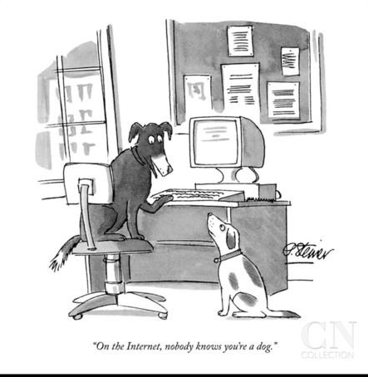
Anonymity?

Slide 38
Correlating data
Netflix Prize Competition: released a de-identified data set with user ID, date, movie name, and the rating given by the user for that movie.
Researchers were able to link users with IMDb's system where the users were identified, and talked about (some of) the movies they watched.
Problem: “Sparsity” of data
In Netflix data, no two profiles are more than 50% similar.
If a Netflix profile is more than 50% similar to a profile in IMDB, then there is a high probability that the two profiles are of the same person
A. Narayanan and V. Shmatikov, “Robust de-anonymization of large sparse datasets …,” Proc. 29th IEEE Symp. Security and Privacy, 2008.

Slide 39
Differential Privacy
When do you feel safe releasing personal information, e.g. completing a survey about your tastes in movies?
My answers have no impact on the privatized released result?
With high probability, an attacker looking at the privatized released result cannot learn any new information about me?
These are not achievable.
Differential privacy aims to maximize the accuracy of queries from statistical databases while minimizing the chances of identifying its records.
The privatized released result is nearly the same whether or not I submit my information.
Dwork and Roth, “Algorithmic Foundations of Differential Privacy,” Foundations and Trends in Theoretical Computer Science (2014).
Notes:
https://t.reembed.com/0dFVes16AKq43QanOK3hDBwC

Slide 40
Ethics Surrounding Algorithms Fairness

Slide 41
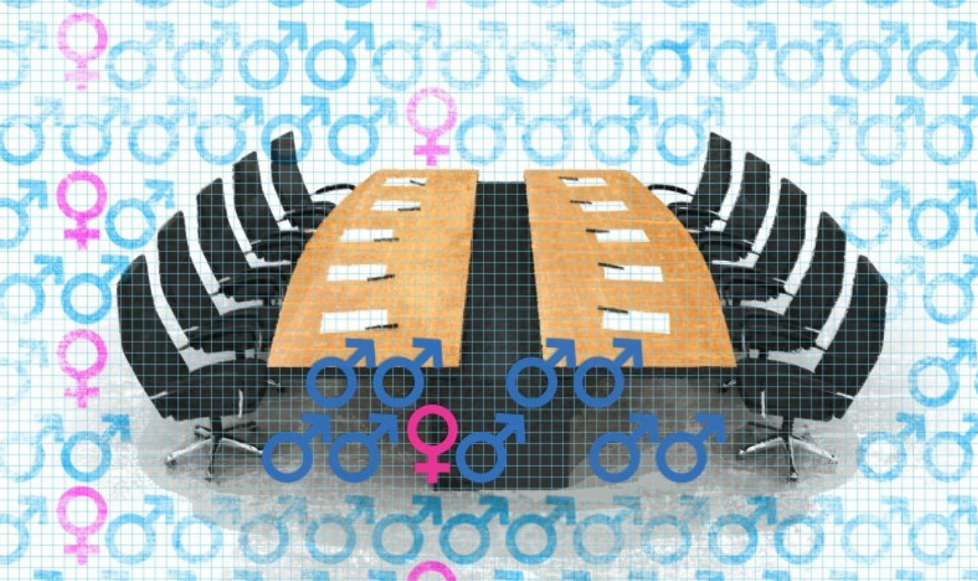
Algorithms are not neutral
Algorithms encode our biases.
Training data set isn’t representative
Past population is not representative of the future population

Slide 42
SAT Score
Number of Credit Cards
Population 1
Population 2

Slide 43
SAT Score
Number of Credit Cards
Population 1
Population 2

Slide 44
SAT Score
Upshot: To be “fair”, the algorithm may need to explicitly take into account group membership.
Else, optimizing accuracy fits the majority population.
Number of Credit Cards
Population 1
Population 2

Slide 45
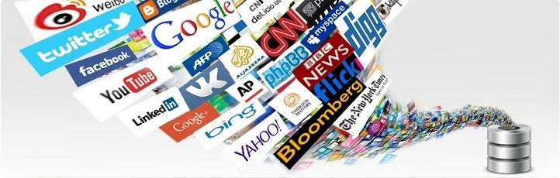

BIASED
AI
Online data is riddled with SOCIAL STEREOTYPES

Slide 46
BIASED
AI
Consequence: models are biased

Slide 47
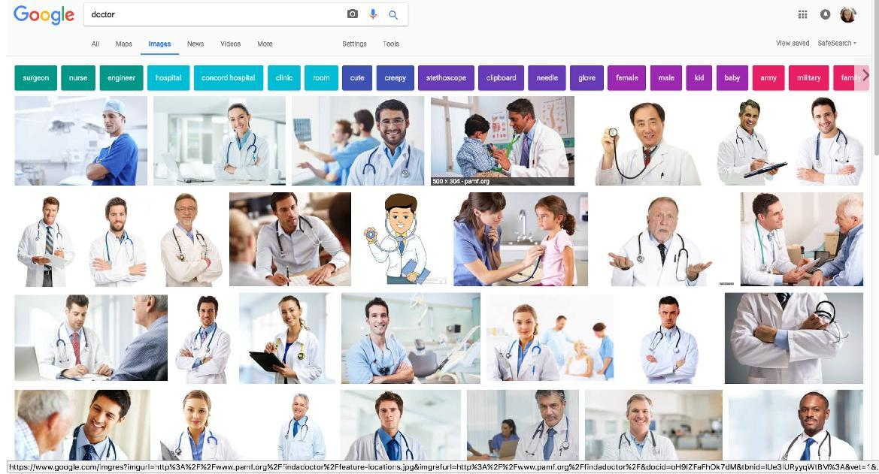
Image Search
June 2017: image search query “Doctor”

Slide 48
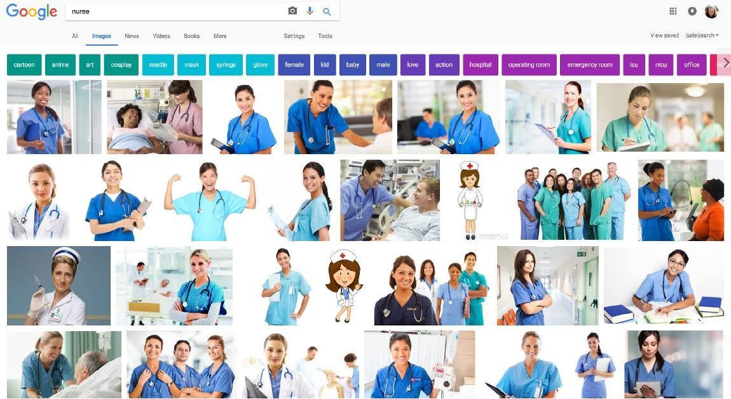
Image Search
June 2017: image search query “Nurse”

Slide 49
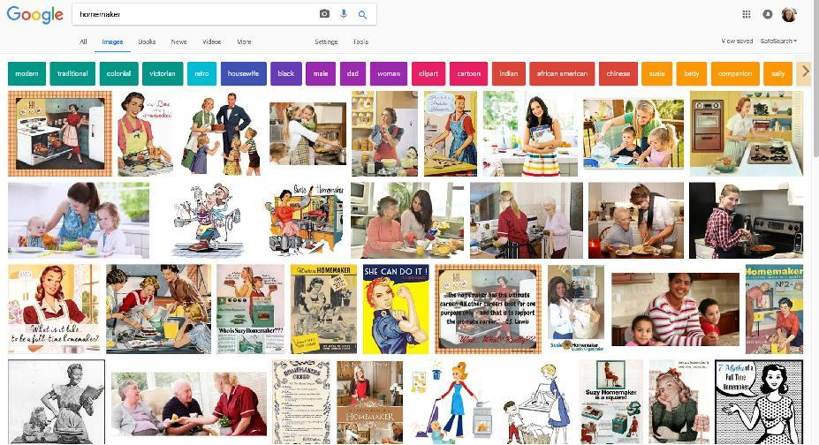
Image Search
June 2017: image search query “Homemaker”

Slide 50
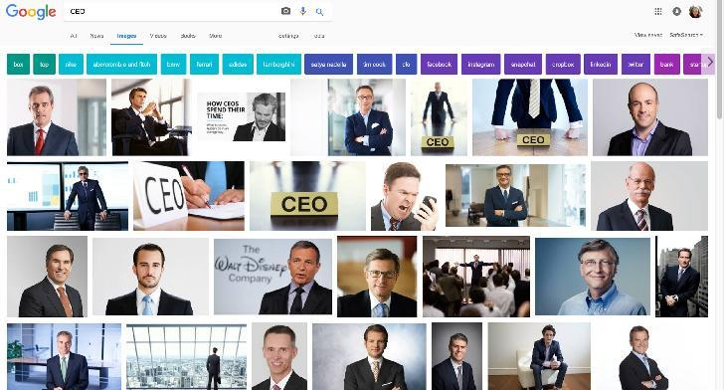
Image Search
June 2017: image search query “CEO”

Slide 51
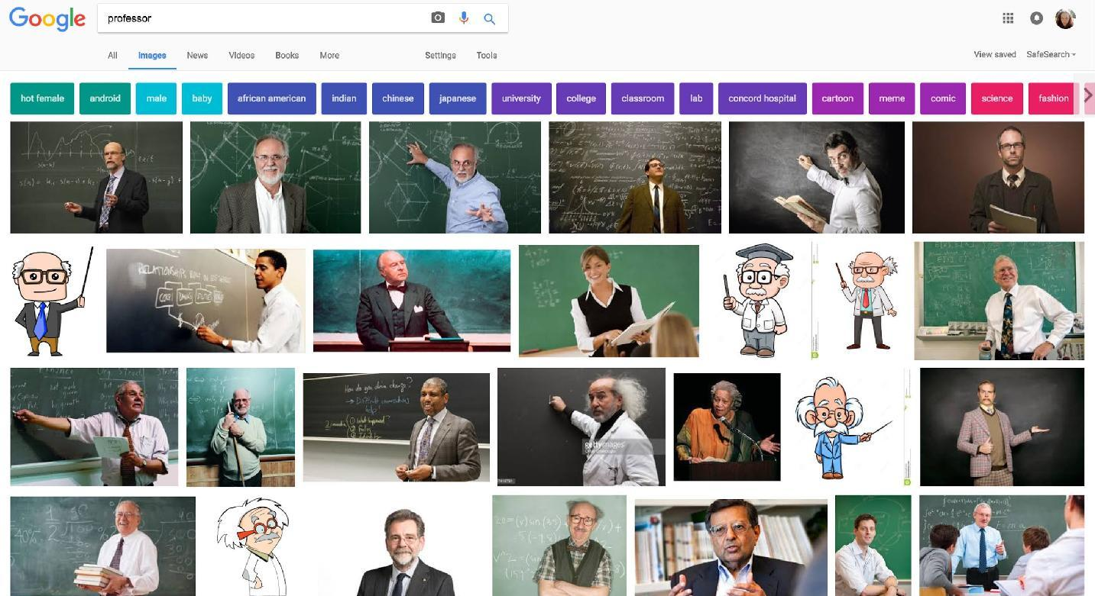
Image Search
June 2017: image search query “Professor”

Slide 52
Fairness
Fairness has been studied in social choice theory, game theory, economics and law.
Currently trendy in theoretical computer science
Discrimination of an individual: An individual from the target group gets treated differently from an otherwise identical individual not from the target group.
Discrimination in aggregate outcome: the percentage success of the target group compared to that of the general population.
Dwork, Hardt, Pitassi, Reingold and Zemel,
“Fairness through Awareness”
Proc. 3rd Innovations in Theoretical Computer Science, 2012.

Slide 53
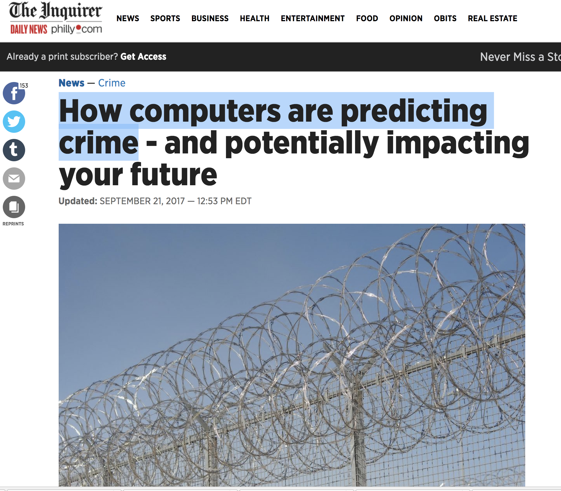
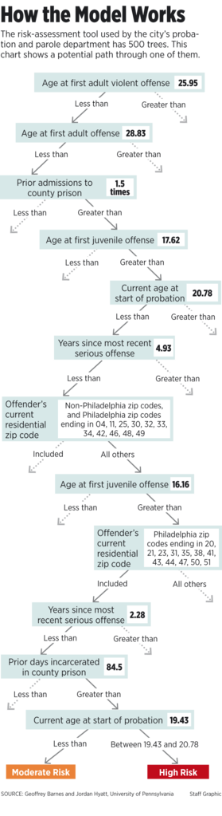
Notes:
Predict probability of re-arrest using a random forest

Slide 54

Why is computer advice on parole controversial?
https://www.propublica.org/article/machine-bias-risk-assessments-in-criminal-sentencing

Slide 55
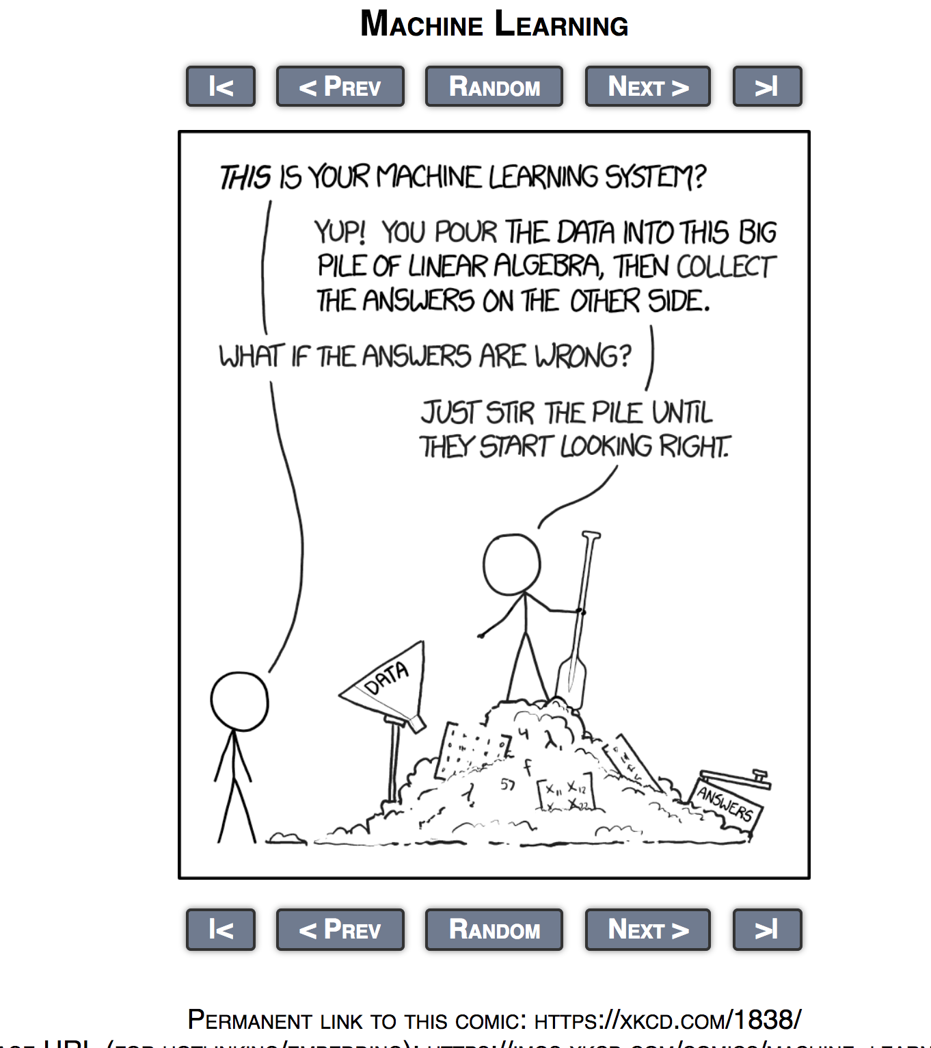
The pile gets soaked with data and starts to get mushy over time, so it's technically recurrent.

Slide 56
Reproducibility
We need to be able to reproduce results but …
The algorithms used in data science are complicated
When things “go wrong”, we need to understand why
Research code is often shared; commercial algorithms less so.
The data often cannot be shared
Notes:
most

Slide 57
Ethics summary
Codes of conduct for research are fairly well understood
Get IRB approval
obtain informed consent
protect the privacy of subjects
maintain the confidentiality of data collected
minimize harm
Fairness is more subtle
What is fair treatment of a group: equal accuracy? FP rate?

